Slide 1

DIGICHROME ACADEMY
NEXT HIKES
2023-24

Slide 2

PROJECT – 05
USER ANALYTICS IN THE TELECOMMUNICATION INDUSTRY - OVERVIEW
ANKUR KUMAR GIRI
2023-24

Slide 3
PROBLEM STATEMENT
AT THE END OF THIS MONTH, YOU ARE EXPECTED TO HAVE A COMPLETE PROJECT THAT HAS
REUSABLE CODE FOR DATA PREPARATION AND CLEANING.
A DASHBOARD THAT SHOWS YOUR FINDINGS.
REUSABLE FEATURE STORE WHICH CAN BE USED TO STORE SELECTED FEATURES FOR LATER USAGE ON SIMILAR PROBLEMS
YOUR PROJECT IN PARTICULAR SHOULD HAVE:
CODE THAT IS INSTALLABLE VIA PIP
HAS UNIT TESTS WITH GOOD TEST COVERAGE
HAS CI/CD SETUP - USING TRAVIS OR GITHUB ACTIONS
HAS DOCKERFILE TO BUILD IT AS A DOCKER IMAGE
THE GLOBAL OBJECTIVE IS DIVIDED INTO 4 SUB-OBJECTIVES
USER OVERVIEW ANALYSIS
USER ENGAGEMENT ANALYSIS
USER EXPERIENCE ANALYSIS
USER SATISFACTION ANALYSIS

Slide 4
SITUATIONAL OVERVIEW (BUSINESS NEED)
YOU ARE WORKING FOR A WEALTHY INVESTOR THAT SPECIALIZES IN PURCHASING ASSETS THAT ARE UNDERVALUED. THIS INVESTOR’S DUE DILIGENCE ON ALL PURCHASES INCLUDES A DETAILED ANALYSIS OF THE DATA THAT UNDERLIES THE BUSINESS, TO TRY TO UNDERSTAND THE FUNDAMENTALS OF THE BUSINESS AND ESPECIALLY TO IDENTIFY OPPORTUNITIES TO DRIVE PROFITABILITY BY CHANGING THE FOCUS OF WHICH PRODUCTS OR SERVICES ARE BEING OFFERED.
YOUR LAST ROLE WITH THIS INVESTOR SAW YOU DO A RICH ANALYSIS OF A DELIVERY COMPANY AND YOU HELPED TO IDENTIFY THAT DELIVERY TO UNIVERSITY STUDENTS WAS THE MOST PROFITABLE ROUTE TO FOLLOW, YOUR ANALYSIS HELPED THE INVESTOR PURCHASE THIS DELIVERY COMPANY AND RAMP UP PROFITS BY 25% WITHIN 6 MONTHS THROUGH FOCUSSING ON THE MOST PROFITABLE ASPECT OF THE BUSINESS.

Slide 5
SITUATIONAL OVERVIEW (BUSINESS NEED)
THE INVESTOR IS INTERESTED IN PURCHASING TELLCO, AN EXISTING MOBILE SERVICE PROVIDER IN THE REPUBLIC OF PEFKAKIA. TELLCO’S CURRENT OWNERS HAVE BEEN WILLING TO SHARE THEIR FINANCIAL INFORMATION BUT HAVE NEVER EMPLOYED ANYONE TO LOOK AT THEIR SYSTEM-GENERATED DATA.
YOUR EMPLOYER WANTS YOU TO PROVIDE A REPORT TO ANALYZE OPPORTUNITIES FOR GROWTH AND MAKE A RECOMMENDATION ON WHETHER TELLCO IS WORTH BUYING OR SELLING. YOU WILL DO THIS BY ANALYZING A TELECOMMUNICATION DATASET THAT CONTAINS USEFUL INFORMATION ABOUT THE CUSTOMERS & THEIR ACTIVITIES ON THE NETWORK. YOU WILL DELIVER INSIGHTS YOU MANAGED TO EXTRACT TO YOUR EMPLOYER THROUGH AN EASY-TO-USE WEB-BASED DASHBOARD AND A WRITTEN REPORT.

Slide 6
EXPLORATORY DATA ANALYSIS (EDA)
CONTENTS
STEPS IN EXPLORATORY DATA ANALYSIS (EDA)
SOFTWARE REQUIREMENTS
FLOW CHART OF EXPLORATORY DATA ANALYSIS .

Slide 7
EXPLORATORY DATA ANALYSIS
EXPLORATORY DATA ANALYSIS (EDA) IS A CRUCIAL INITIAL STEP IN ANY DATA ANALYSIS PROJECT. IT INVOLVES EXAMINING AND UNDERSTANDING THE CHARACTERISTICS, PATTERNS, AND RELATIONSHIPS PRESENT IN A DATASET. EDA ALLOWS DATA SCIENTISTS AND ANALYSTS TO GAIN INSIGHTS INTO THE DATA, IDENTIFY POTENTIAL PROBLEMS OR ANOMALIES, AND FORMULATE HYPOTHESES FOR FURTHER INVESTIGATION.
UNDERSTAND THE DATA: GET A COMPREHENSIVE UNDERSTANDING OF THE DATASET, INCLUDING ITS STRUCTURE, VARIABLES, AND THEIR TYPES. THIS INVOLVES EXPLORING THE DIMENSIONS OF THE DATASET (NUMBER OF ROWS AND COLUMNS), DATA TYPES (NUMERIC, CATEGORICAL, ETC.), AND ANY MISSING OR NULL VALUES.

Slide 8
EXPLORATORY DATA ANALYSIS
DETECT PATTERNS AND RELATIONSHIPS: IDENTIFY PATTERNS, TRENDS, AND RELATIONSHIPS BETWEEN VARIABLES IN THE DATASET. THIS INCLUDES EXAMINING DISTRIBUTIONS, CORRELATIONS, AND DEPENDENCIES AMONG DIFFERENT FEATURES
UNCOVER ANOMALIES AND OUTLIERS: DETECT ANY OUTLIERS OR ANOMALIES THAT MAY INDICATE ERRORS IN DATA COLLECTION OR PROCESSING. THESE OUTLIERS COULD BE LEGITIMATE DATA POINTS WITH UNUSUAL CHARACTERISTICS OR ERRORS THAT NEED TO BE ADDRESSED.
FORMULATE HYPOTHESES: BASED ON THE INSIGHTS GAINED FROM EDA, GENERATE HYPOTHESES OR RESEARCH QUESTIONS TO EXPLORE FURTHER THROUGH STATISTICAL ANALYSIS OR MACHINE LEARNING MODELING

Slide 9
EXPLORATORY DATA ANALYSIS
EDA IS TYPICALLY PERFORMED USING A COMBINATION OF DESCRIPTIVE STATISTICS, DATA VISUALIZATION TECHNIQUES, AND SOMETIMES, ADVANCED ANALYTICS METHODS. DESCRIPTIVE STATISTICS HELP SUMMARIZE THE CENTRAL TENDENCY, DISPERSION, AND SHAPE OF THE DATA, WHILE VISUALIZATION TECHNIQUES SUCH AS HISTOGRAMS, SCATTER PLOTS, BOX PLOTS, AND HEATMAPS PROVIDE GRAPHICAL REPRESENTATIONS OF THE DATA DISTRIBUTION AND RELATIONSHIPS.
EDA IS AN ITERATIVE PROCESS, WHERE INSIGHTS GAINED AT EACH STAGE MAY LEAD TO FURTHER EXPLORATION OR REFINEMENT OF ANALYSIS TECHNIQUES. IT SERVES AS A FOUNDATION FOR MORE ADVANCED ANALYSIS AND MODELING TASKS, HELPING ENSURE THAT SUBSEQUENT ANALYSES ARE BASED ON A SOLID UNDERSTANDING OF THE DATASET.
IN SUMMARY, EXPLORATORY DATA ANALYSIS IS A CRITICAL PHASE IN THE DATA ANALYSIS WORKFLOW, ENABLING DATA SCIENTISTS AND ANALYSTS TO GAIN INSIGHTS, IDENTIFY PATTERNS, AND FORMULATE HYPOTHESES TO GUIDE FURTHER ANALYSIS AND DECISION-MAKING.

Slide 10
STEPS IN EXPLORATORY DATA ANALYSIS (EDA)
EXPLORATORY DATA ANALYSIS (EDA) IS A CRITICAL STEP IN DATA ANALYSIS WHERE YOU EXAMINE AND SUMMARIZE THE MAIN CHARACTERISTICS OF A DATASET, USUALLY THROUGH VISUALIZATION AND DESCRIPTIVE STATISTICS. IT HELPS YOU UNDERSTAND YOUR DATA, FIND PATTERNS, DETECT ANOMALIES, AND FORMULATE HYPOTHESES FOR FURTHER ANALYSIS. EDA INVOLVES TASKS LIKE:
DATA CLEANING: HANDLING MISSING VALUES, DEALING WITH OUTLIERS, AND RESOLVING INCONSISTENCIES IN THE DATA.
DESCRIPTIVE STATISTICS: COMPUTING MEASURES LIKE MEAN, MEDIAN, MODE, STANDARD DEVIATION, ETC., TO UNDERSTAND THE CENTRAL TENDENCY AND DISPERSION OF THE DATA.
VISUALIZATION: CREATING PLOTS SUCH AS HISTOGRAMS, BOX PLOTS, SCATTER PLOTS, AND HEATMAPS TO VISUALIZE THE DISTRIBUTION, RELATIONSHIPS, AND TRENDS IN THE DATA.
FEATURE ENGINEERING: CREATING NEW FEATURES FROM EXISTING ONES OR TRANSFORMING FEATURES TO BETTER REPRESENT THE UNDERLYING PATTERNS IN THE DATA.

Slide 11
STEPS IN EXPLORATORY DATA ANALYSIS (EDA)
EXPLORATORY DATA ANALYSIS (EDA) IS A CRITICAL STEP IN DATA ANALYSIS WHERE YOU EXAMINE AND SUMMARIZE THE MAIN CHARACTERISTICS OF A DATASET, USUALLY THROUGH VISUALIZATION AND DESCRIPTIVE STATISTICS. IT HELPS YOU UNDERSTAND YOUR DATA, FIND PATTERNS, DETECT ANOMALIES, AND FORMULATE HYPOTHESES FOR FURTHER ANALYSIS. EDA INVOLVES TASKS LIKE:
DATA CLEANING: HANDLING MISSING VALUES, DEALING WITH OUTLIERS, AND RESOLVING INCONSISTENCIES IN THE DATA.
DESCRIPTIVE STATISTICS: COMPUTING MEASURES LIKE MEAN, MEDIAN, MODE, STANDARD DEVIATION, ETC., TO UNDERSTAND THE CENTRAL TENDENCY AND DISPERSION OF THE DATA.
VISUALIZATION: CREATING PLOTS SUCH AS HISTOGRAMS, BOX PLOTS, SCATTER PLOTS, AND HEATMAPS TO VISUALIZE THE DISTRIBUTION, RELATIONSHIPS, AND TRENDS IN THE DATA.
DIMENSIONALITY REDUCTION: TECHNIQUES LIKE PRINCIPAL COMPONENT ANALYSIS (PCA) OR T-DISTRIBUTED STOCHASTIC NEIGHBOR EMBEDDING (T-SNE) TO REDUCE THE NUMBER OF FEATURES AND SIMPLIFY THE DATASET WHILE PRESERVING ITS ESSENTIAL CHARACTERISTICS.

Slide 12
STEPS IN EXPLORATORY DATA ANALYSIS (EDA)
CORRELATION ANALYSIS: EXAMINING THE RELATIONSHIPS BETWEEN VARIABLES TO IDENTIFY POTENTIAL DEPENDENCIES OR MULTICOLLINEARITY
UNDERSTANDING THE DATA: START BY LOADING YOUR DATASET AND UNDERSTANDING ITS STRUCTURE. LOOK AT THE DIMENSIONS (NUMBER OF ROWS AND COLUMNS), DATA TYPES, AND ANY MISSING VALUES. THIS STAGE INVOLVES GETTING A GENERAL SENSE OF WHAT INFORMATION IS AVAILABLE AND ITS QUALITY.
UNIVARIATE ANALYSIS: ANALYZE INDIVIDUAL VARIABLES ONE AT A TIME. THIS CAN INVOLVE COMPUTING SUMMARY STATISTICS LIKE MEAN, MEDIAN, AND STANDARD DEVIATION FOR NUMERICAL VARIABLES, AND FREQUENCY TABLES OR BAR PLOTS FOR CATEGORICAL VARIABLES. HISTOGRAMS, DENSITY PLOTS, AND BOX PLOTS ARE USEFUL FOR VISUALIZING THE DISTRIBUTION AND SPREAD OF NUMERICAL VARIABLES.
BIVARIATE ANALYSIS: EXPLORE RELATIONSHIPS BETWEEN PAIRS OF VARIABLES. THIS CAN INVOLVE SCATTER PLOTS FOR NUMERIC VARIABLES, OR CONTINGENCY TABLES AND HEATMAP CORRELATION MATRICES FOR CATEGORICAL VARIABLES. UNDERSTANDING THESE RELATIONSHIPS CAN PROVIDE INSIGHTS INTO POTENTIAL PATTERNS OR DEPENDENCIES IN THE DATA.

Slide 13
STEPS IN EXPLORATORY DATA ANALYSIS (EDA)
MULTIVARIATE ANALYSIS: INVESTIGATE INTERACTIONS BETWEEN THREE OR MORE VARIABLES. THIS CAN INVOLVE TECHNIQUES LIKE CLUSTER ANALYSIS, FACTOR ANALYSIS, OR MULTIDIMENSIONAL SCALING TO IDENTIFY GROUPS OR PATTERNS WITHIN THE DATA.
STATISTICAL TESTING: PERFORM STATISTICAL TESTS TO VALIDATE HYPOTHESES OR ASSESS THE SIGNIFICANCE OF RELATIONSHIPS OBSERVED DURING THE ANALYSIS. THIS CAN INCLUDE T-TESTS, ANOVA, CHI-SQUARE TESTS, AND CORRELATION TESTS, DEPENDING ON THE NATURE OF YOUR DATA AND RESEARCH QUESTIONS
DIMENSIONALITY REDUCTION: TECHNIQUES LIKE PRINCIPAL COMPONENT ANALYSIS (PCA) OR T-DISTRIBUTED STOCHASTIC NEIGHBOR EMBEDDING (T-SNE) TO REDUCE THE NUMBER OF FEATURES AND SIMPLIFY THE DATASET WHILE PRESERVING ITS ESSENTIAL CHARACTERISTICS.
FEATURE ENGINEERING: CREATING NEW FEATURES FROM EXISTING ONES OR TRANSFORMING FEATURES TO BETTER REPRESENT THE UNDERLYING PATTERNS IN THE DATA.

Slide 14
SOFTWARE REQUIREMENTS
GOOGLE DRIVE
COLAB

Slide 15
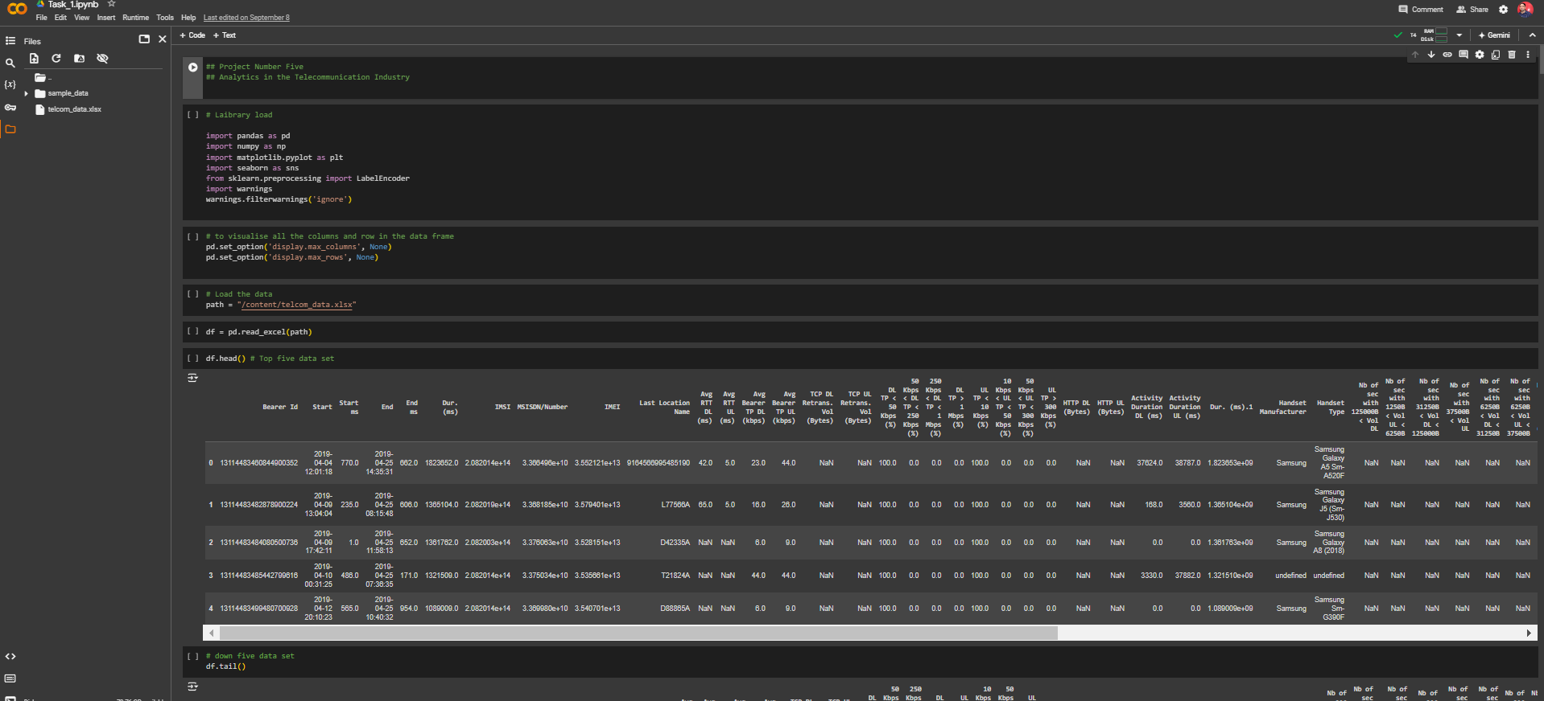

Slide 16
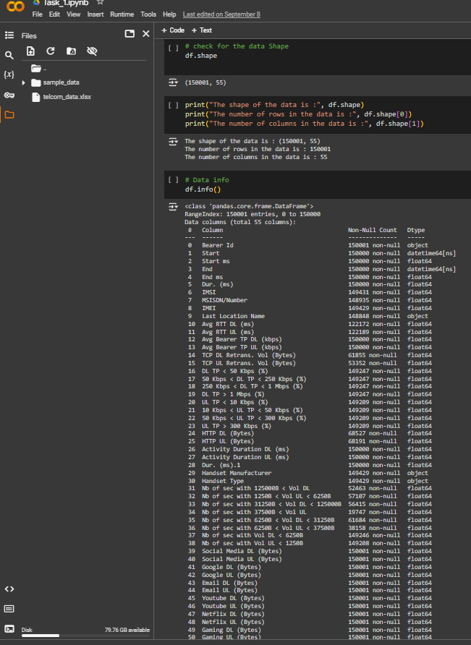
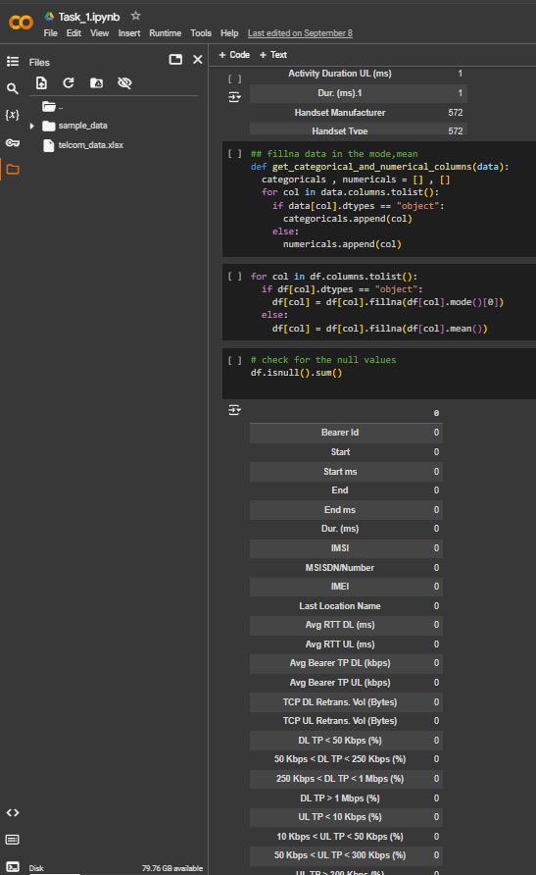
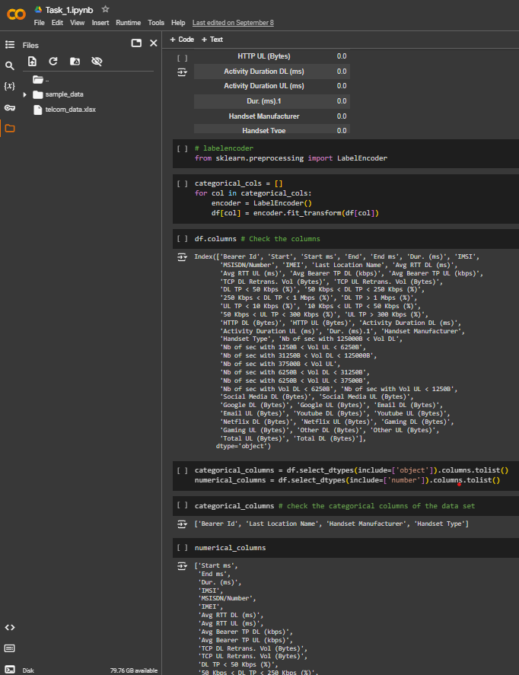

Slide 17
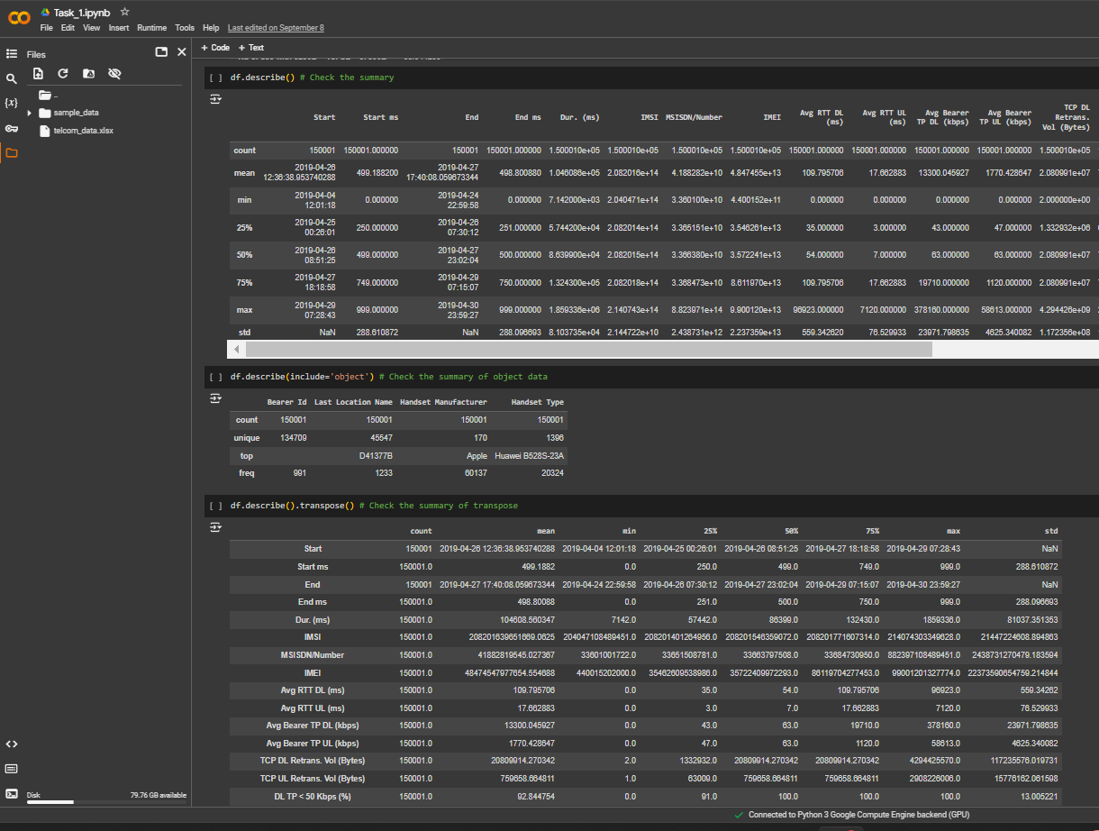
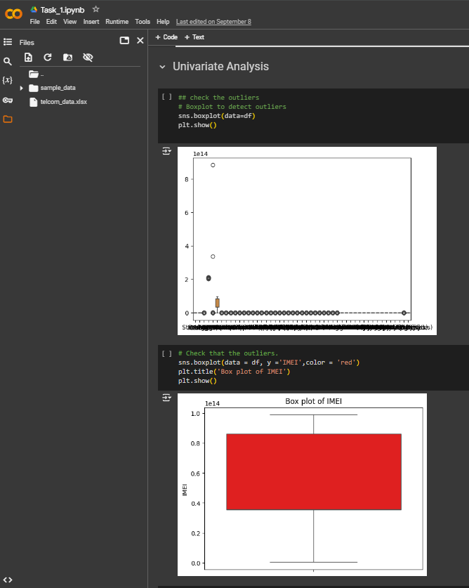

Slide 18
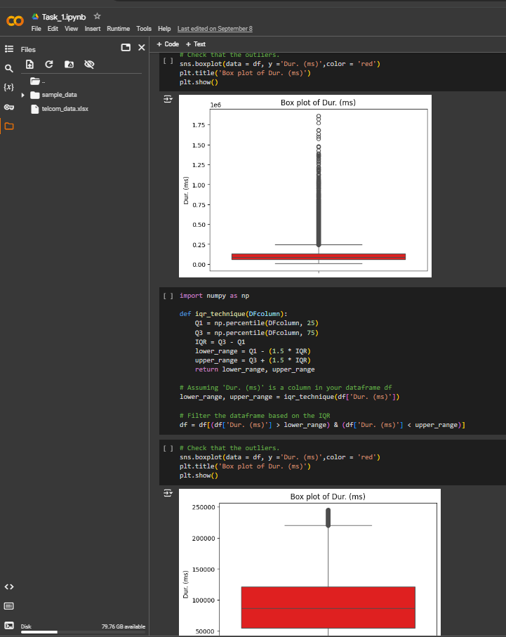
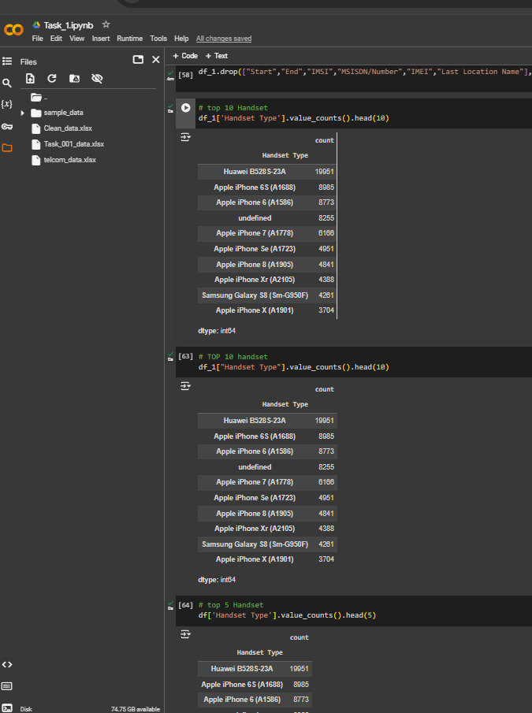

Slide 19
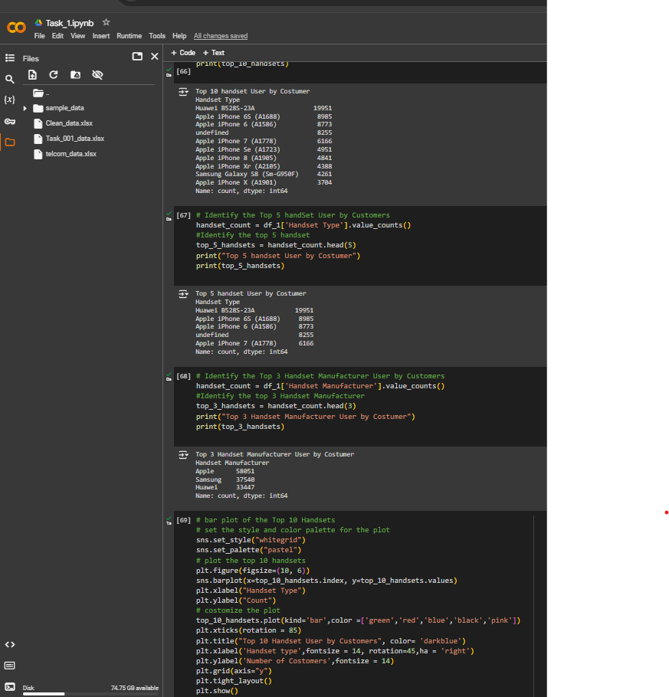
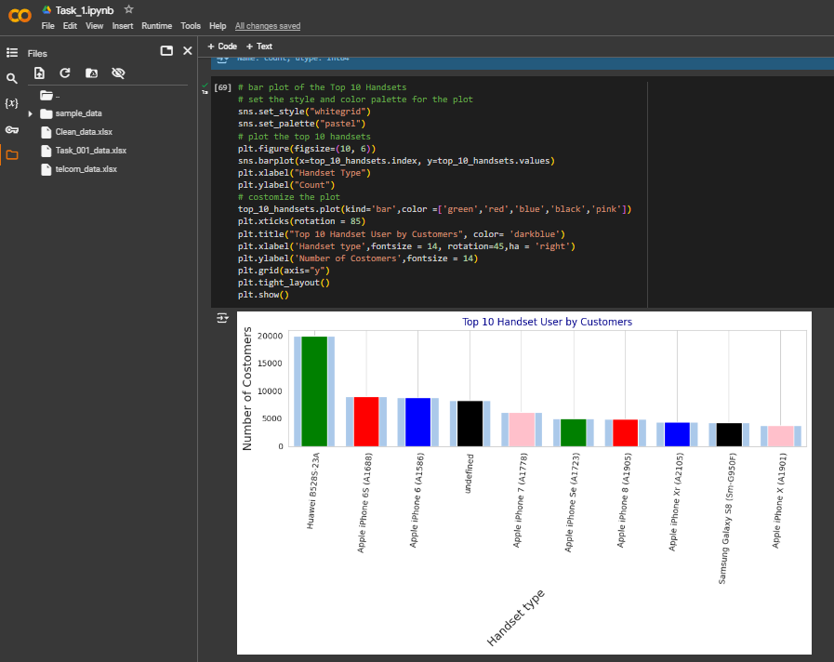

Slide 20
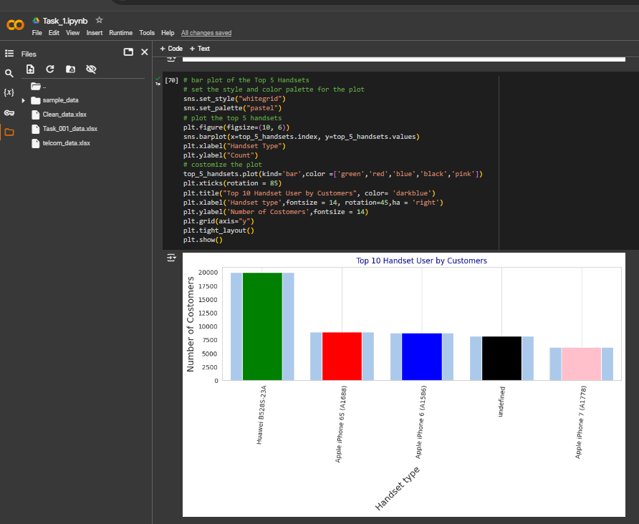
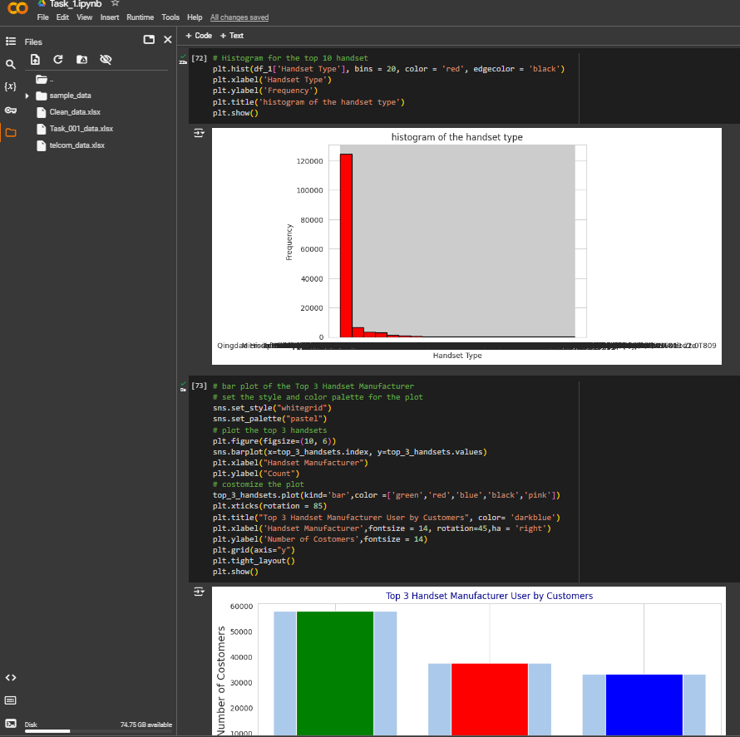

Slide 21
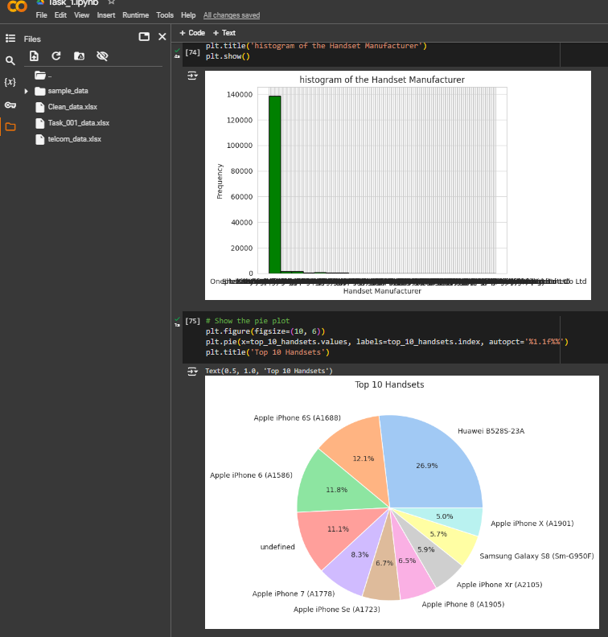
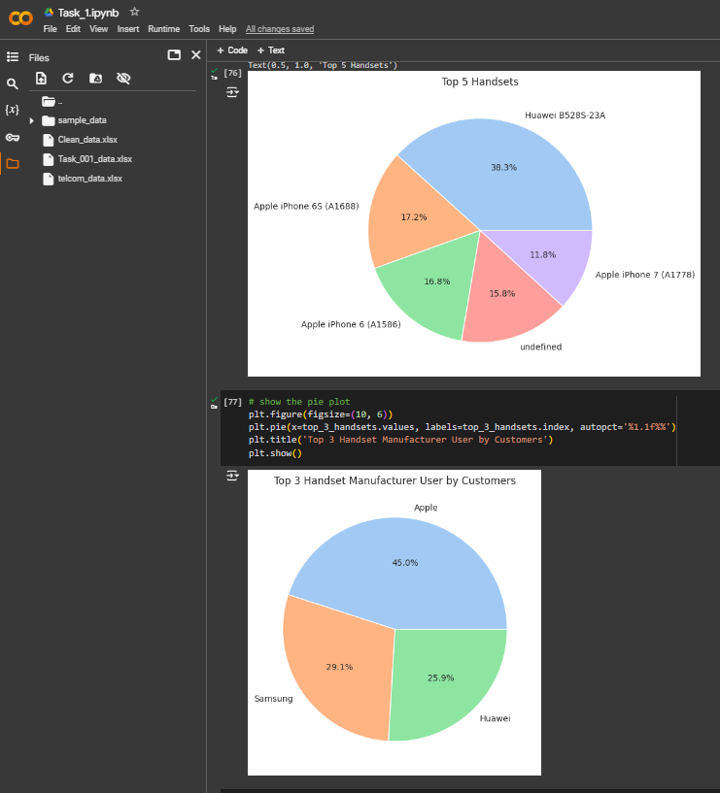

Slide 22
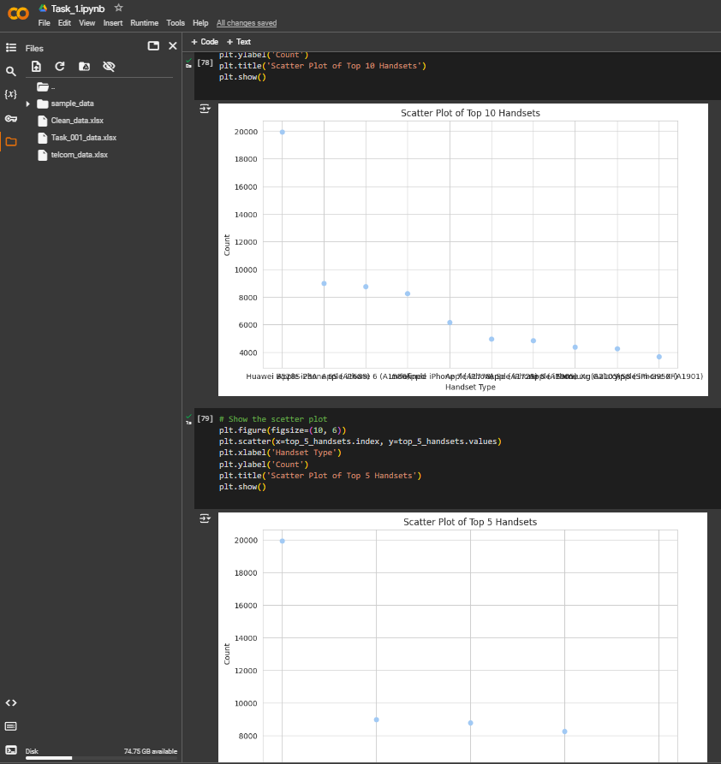
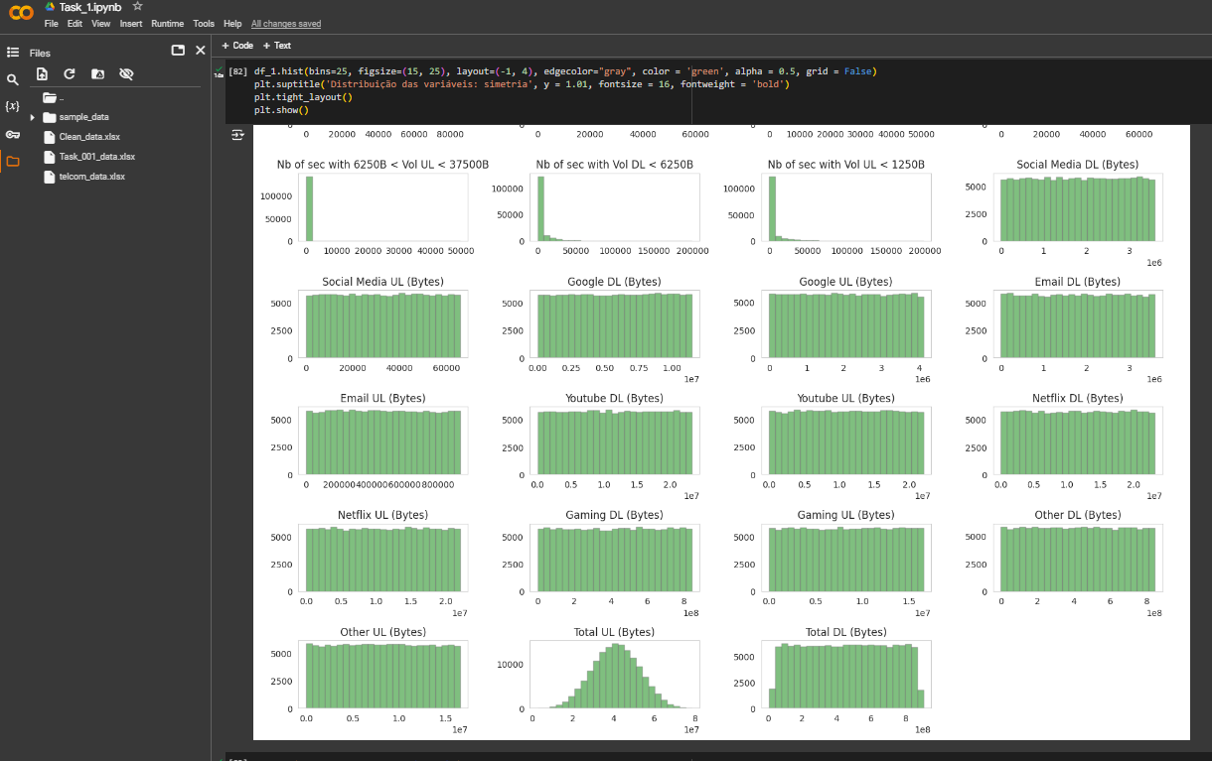

Slide 23
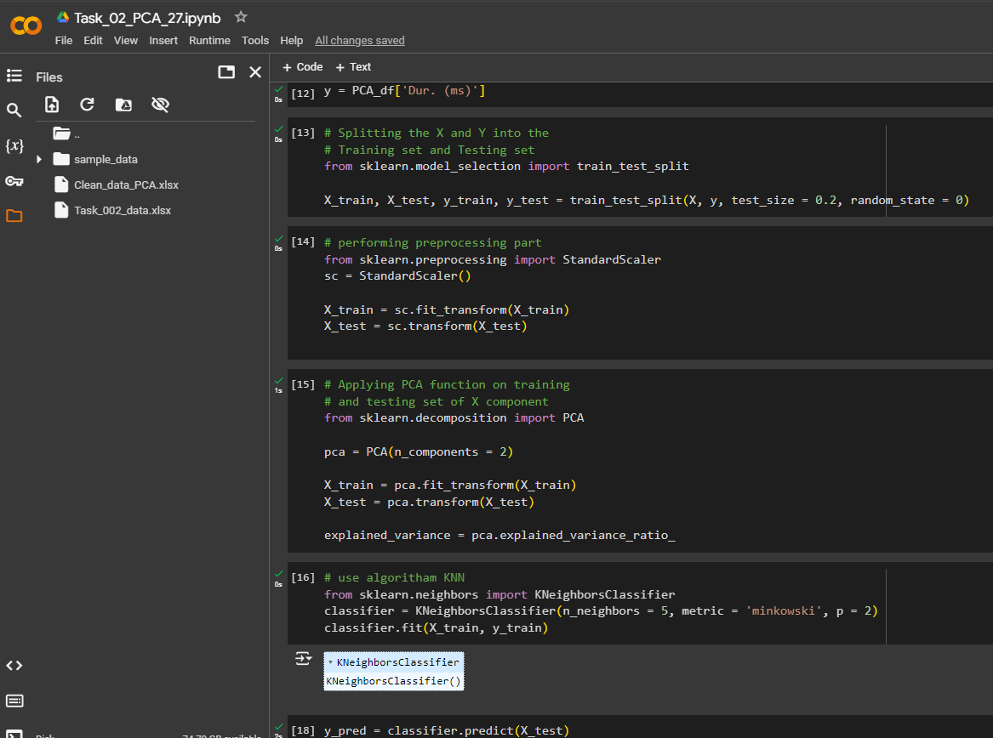
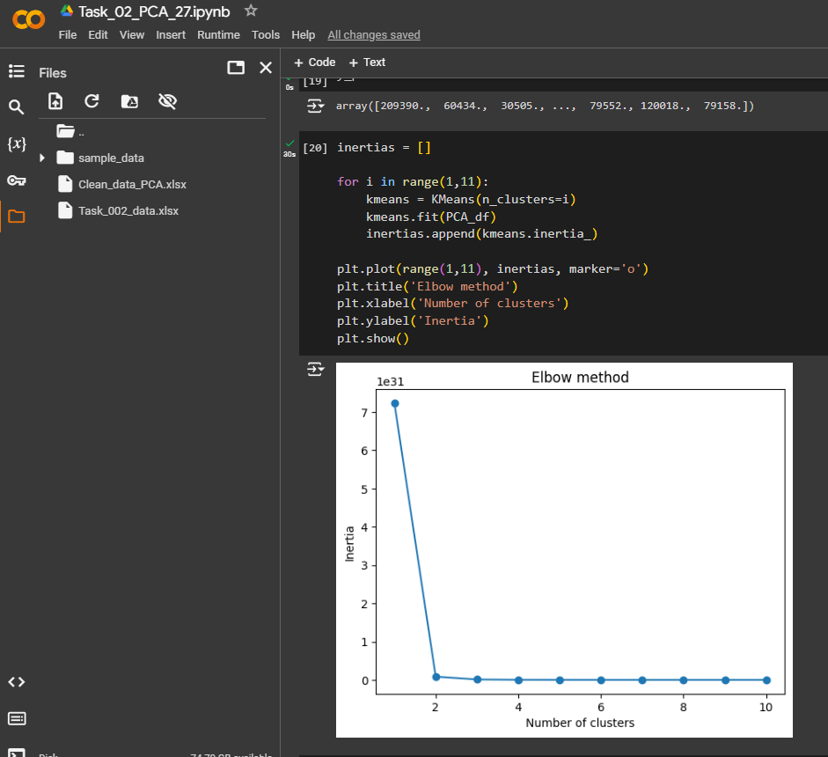

Slide 24
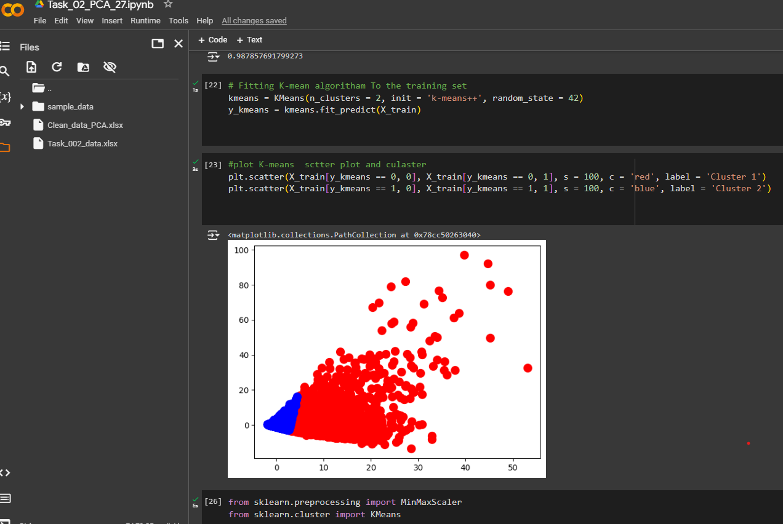
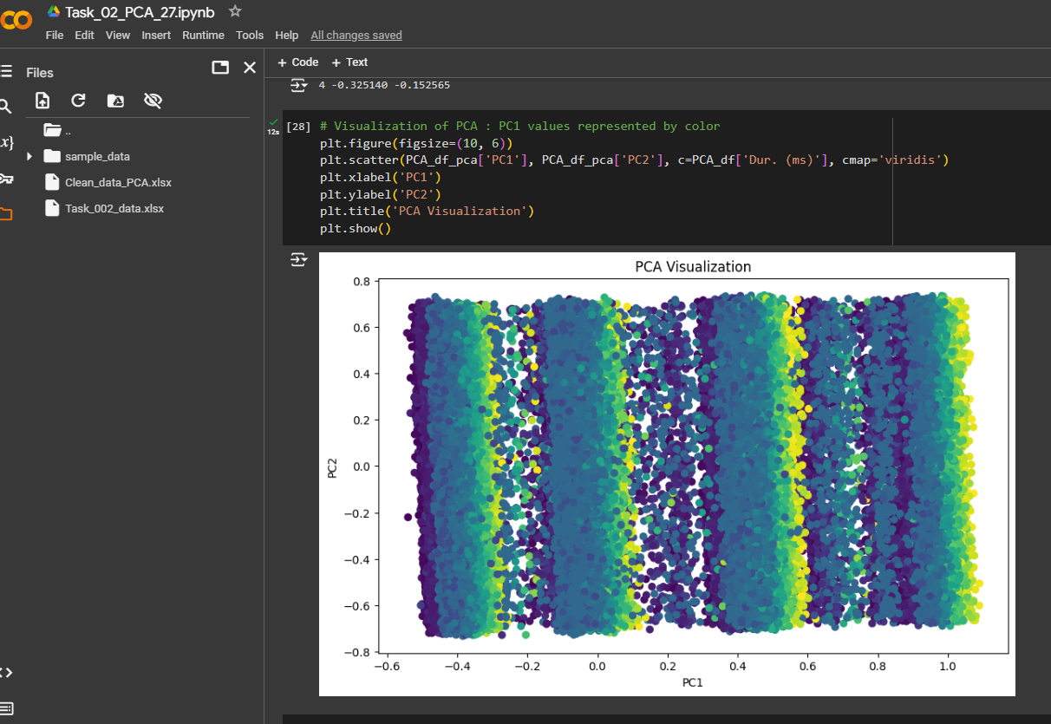

Slide 25
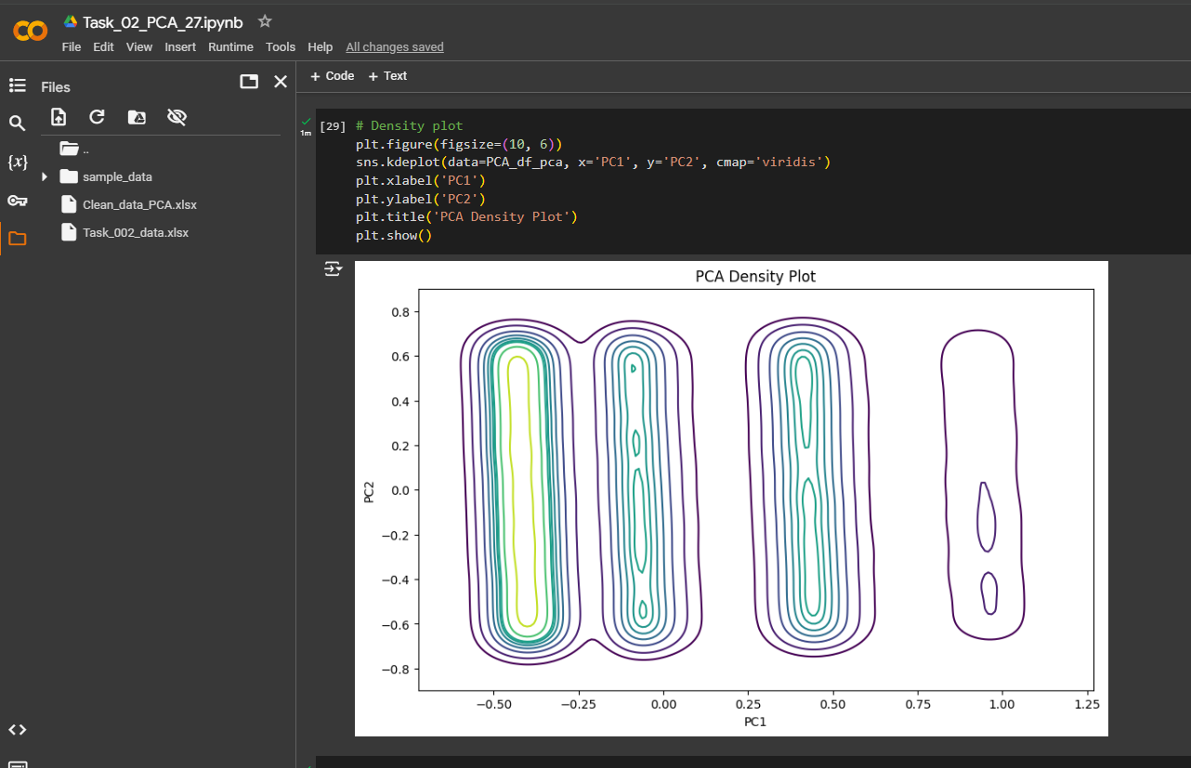
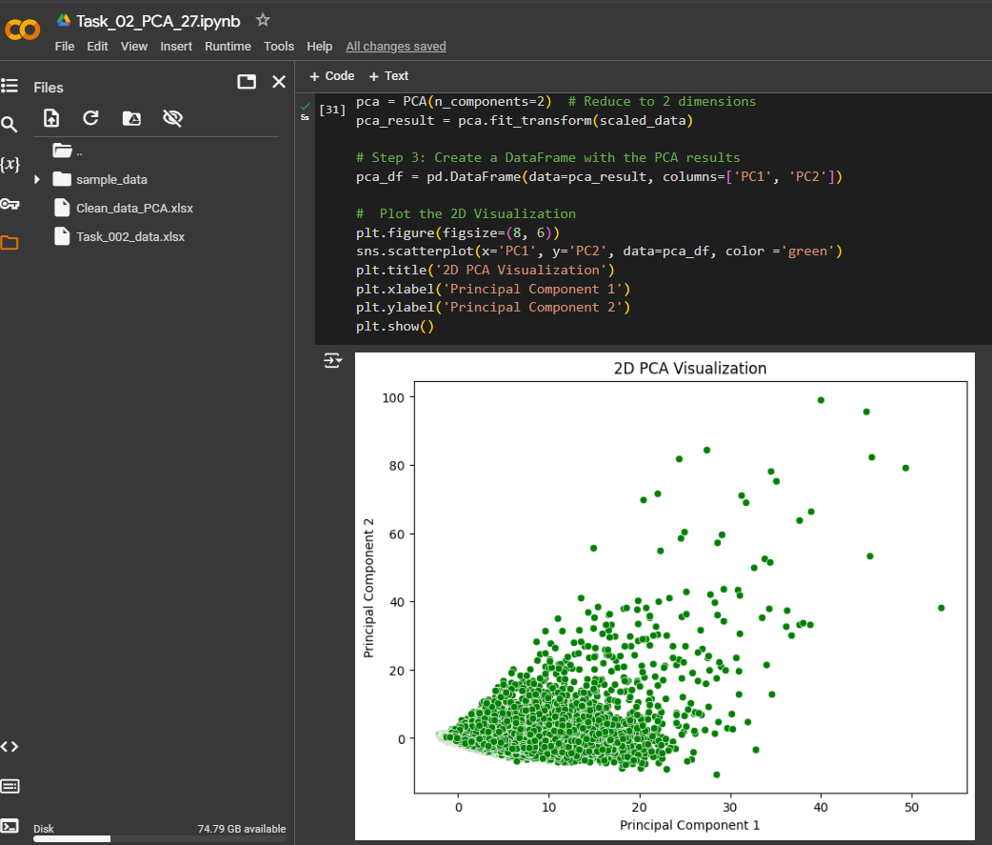

Slide 26
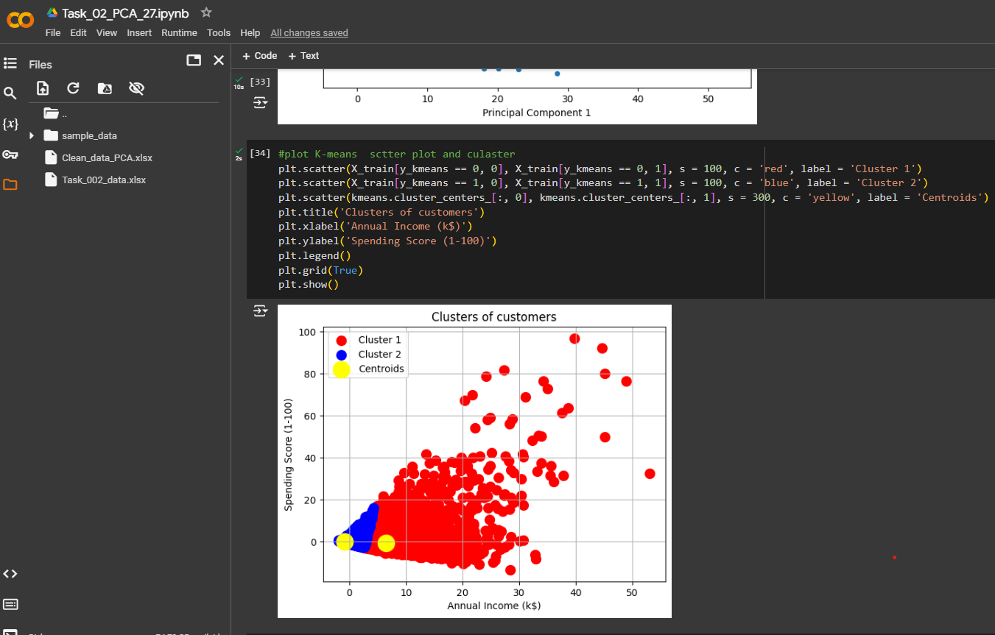
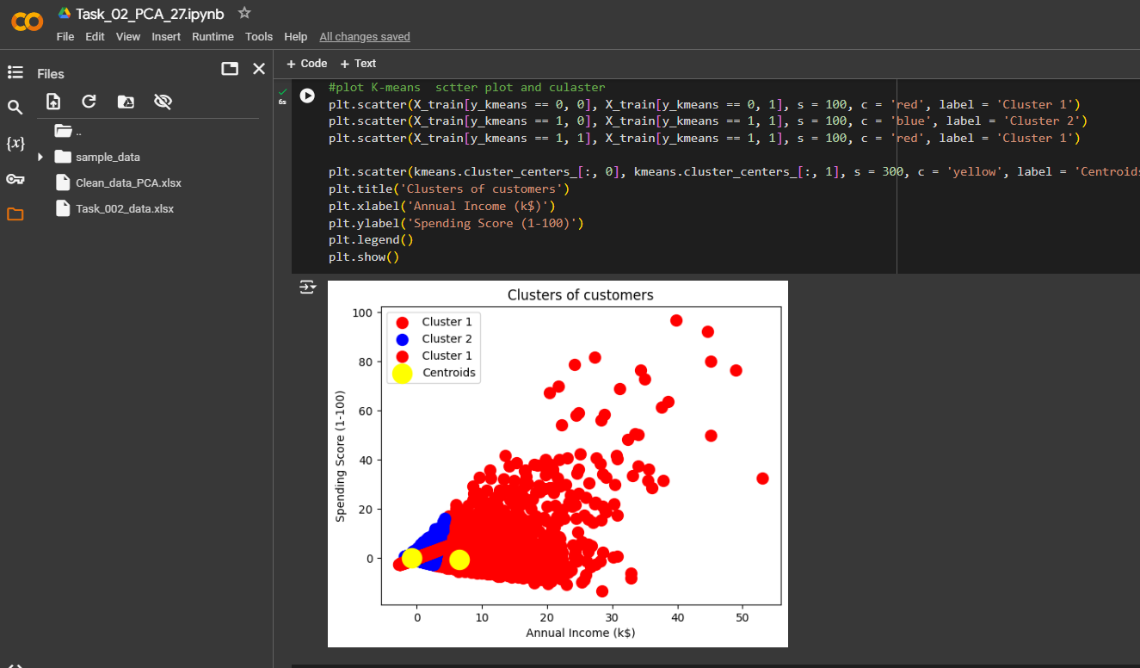

Slide 27
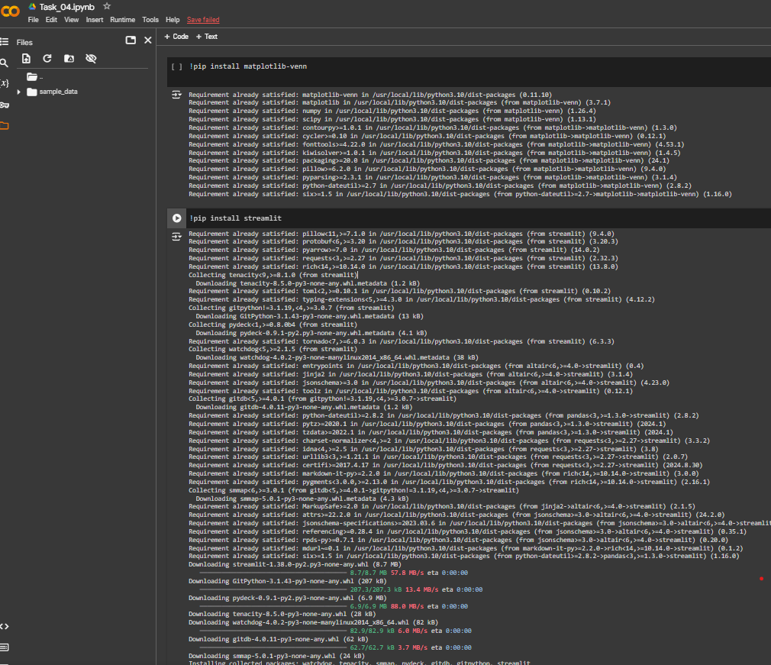
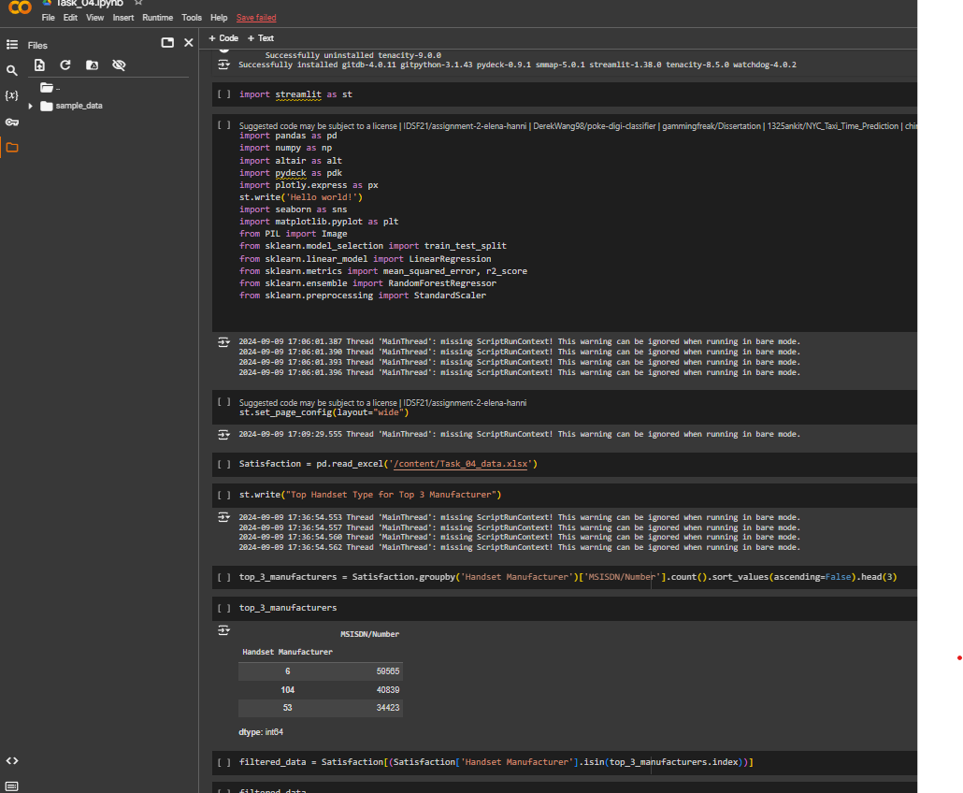
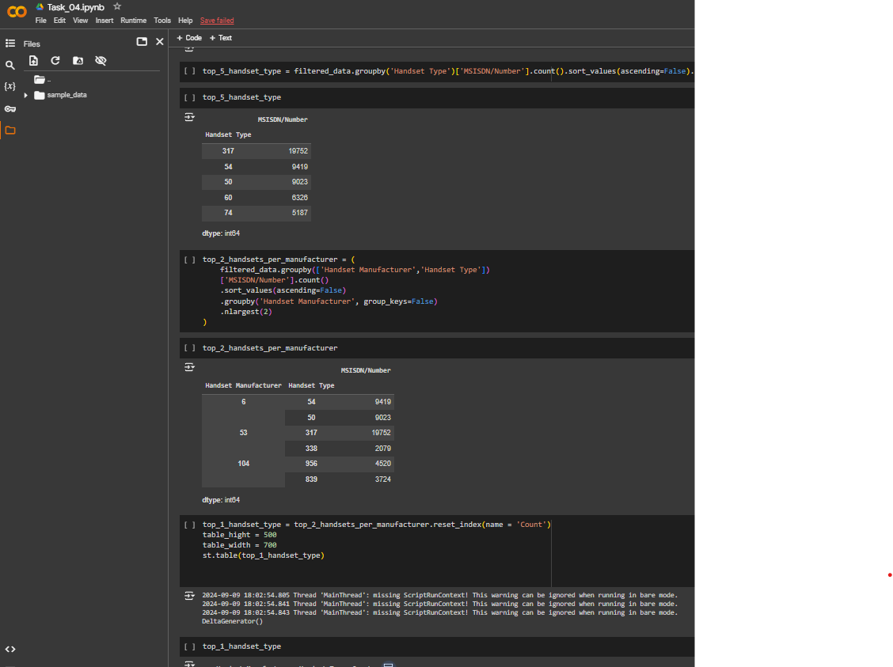

Slide 28
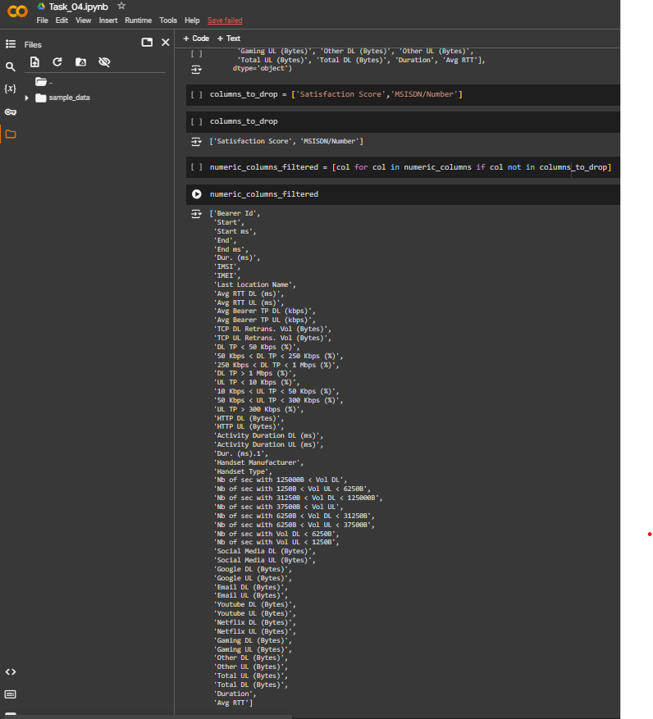
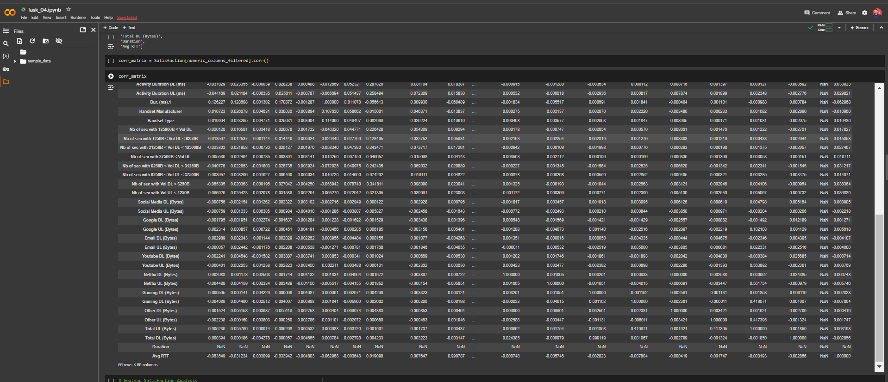

Slide 29
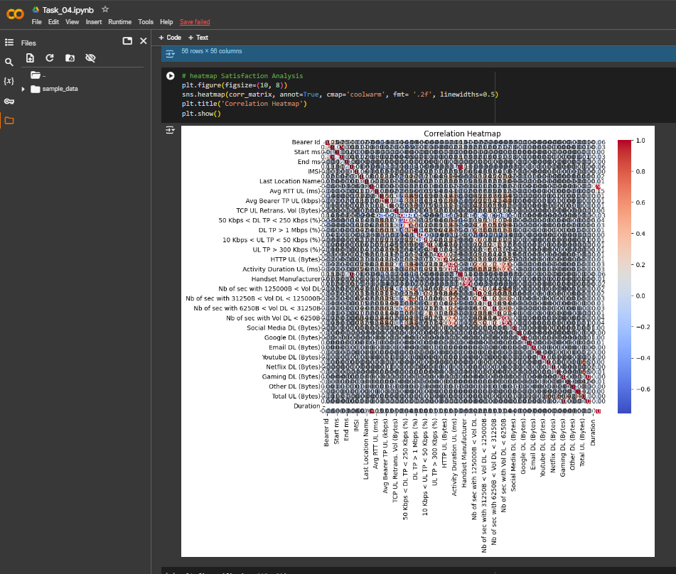
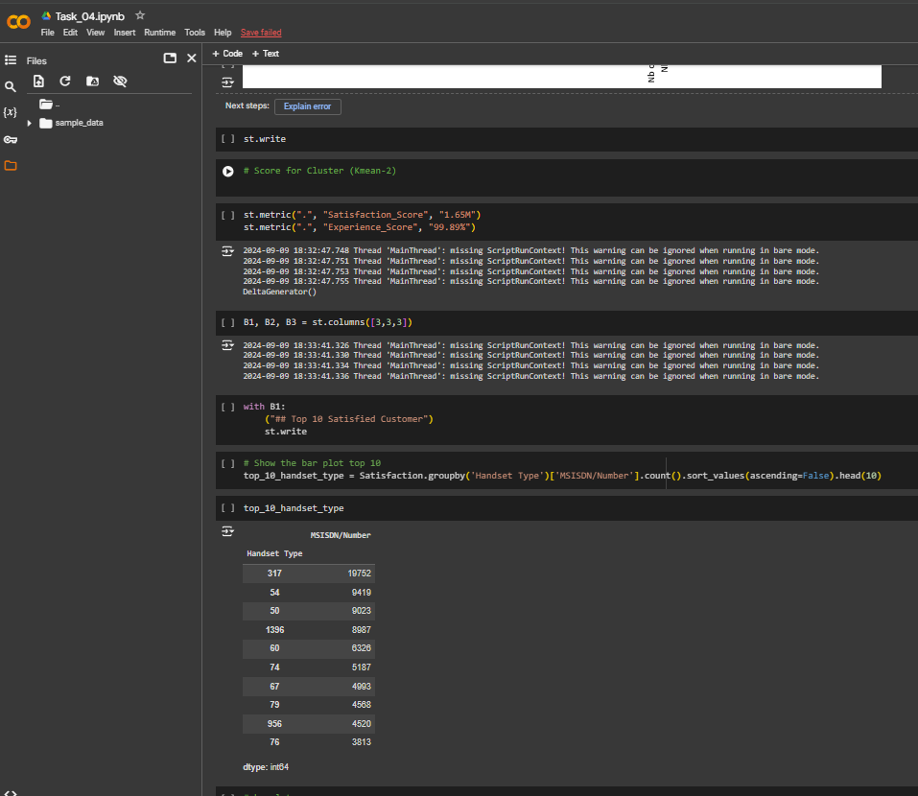

Slide 30
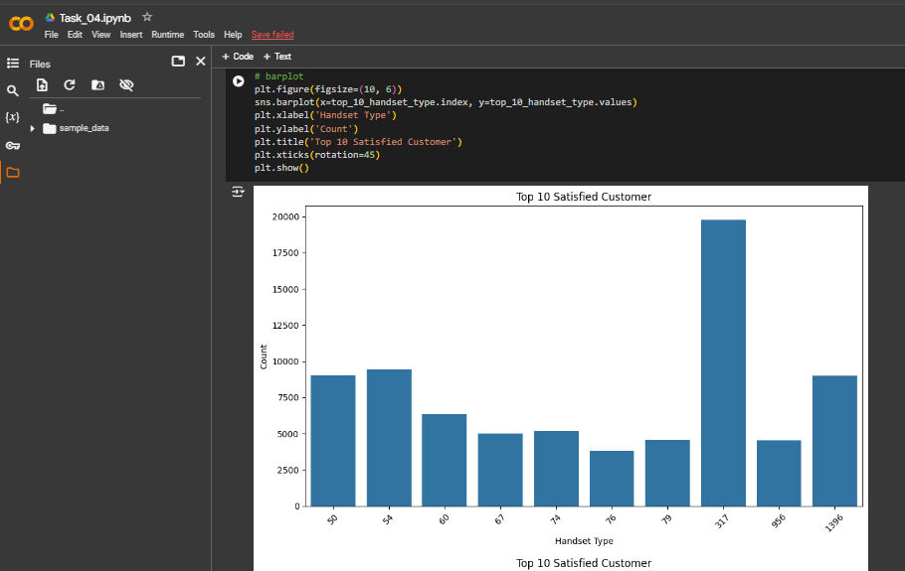
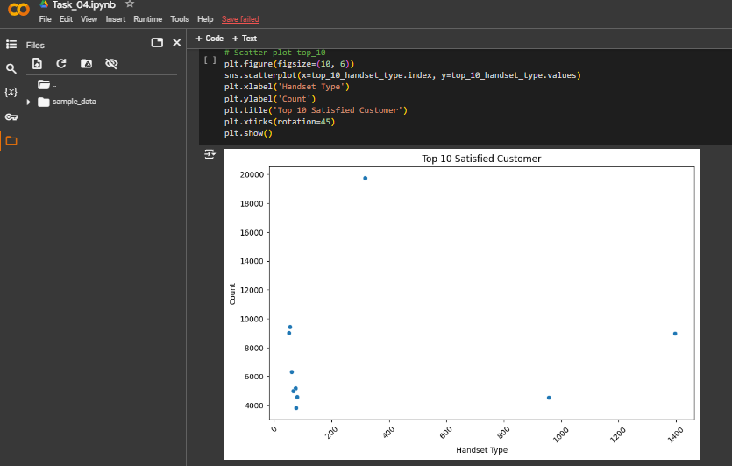

Slide 31
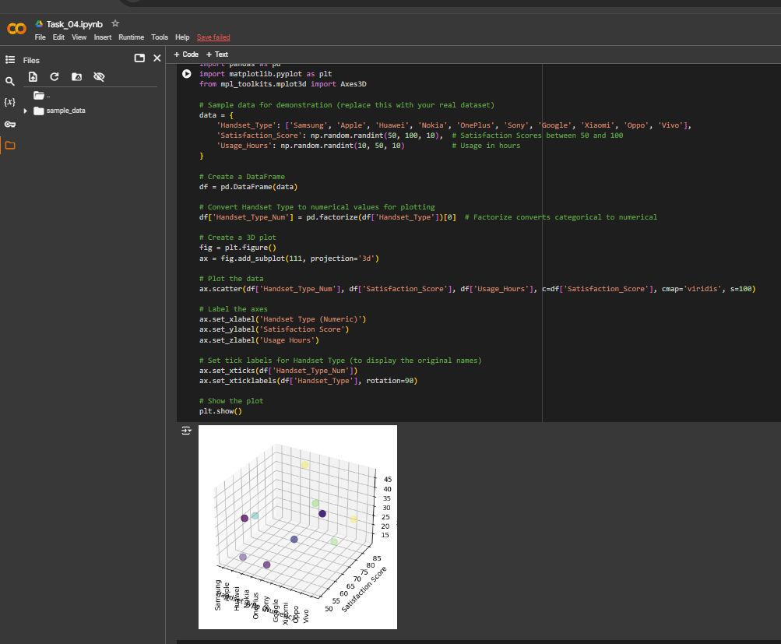
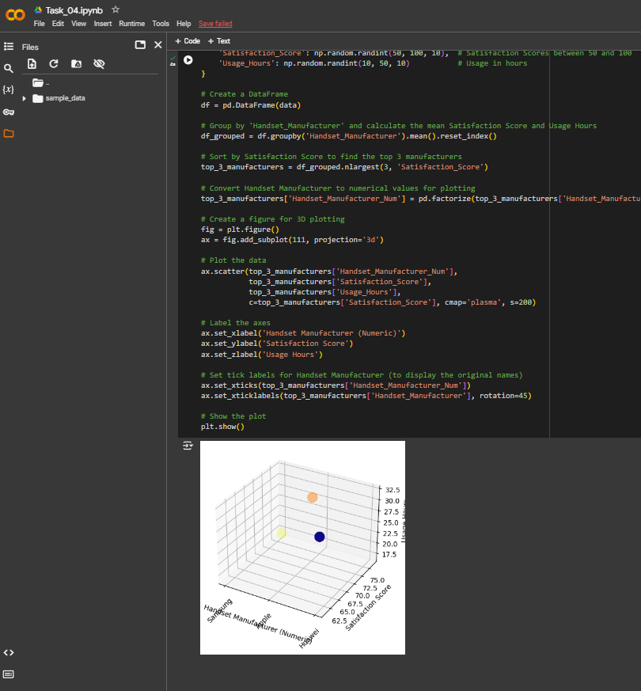

Slide 32
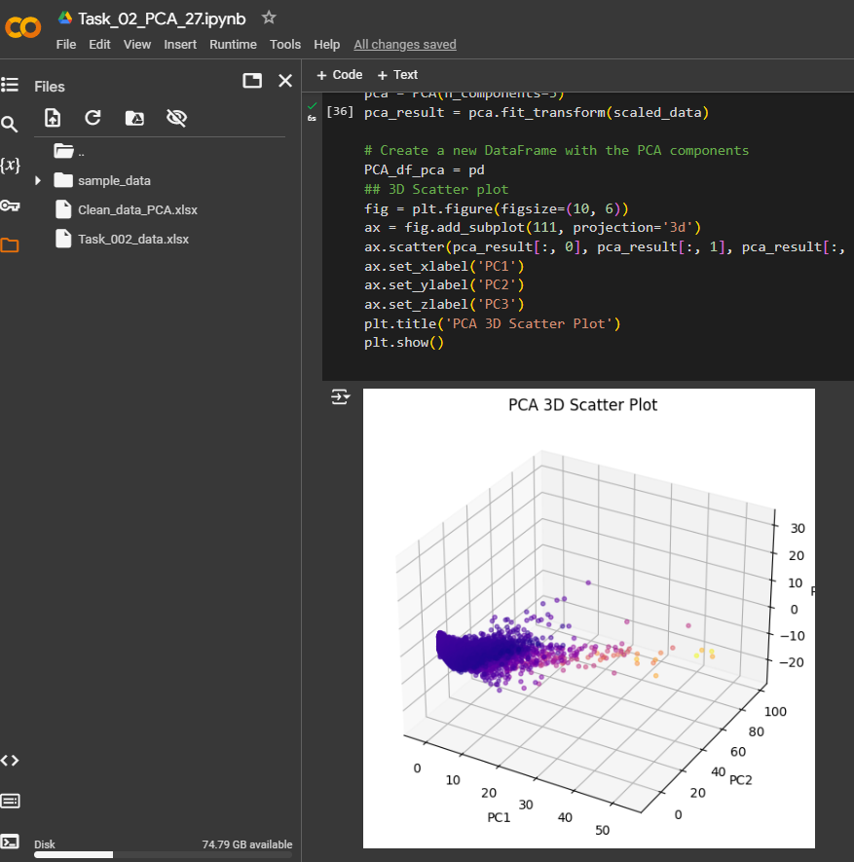
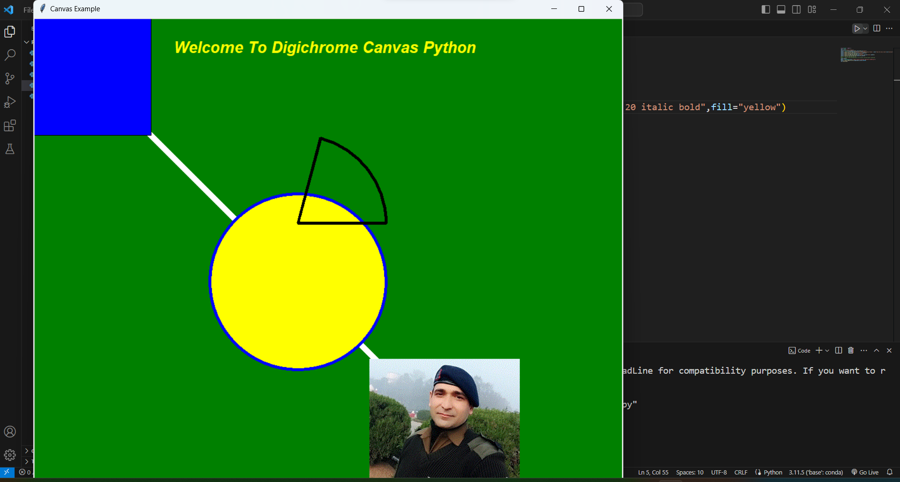
JAI HIND

